Slide 1

INTRODUCTION TO AI

Slide 2
WHAT IS ARTIFICIAL INTELIGENCE (AI)?
Decision Making Machine
A series of IFs
Replication of the Human Brain
Simulation of Human Inteligence without the emotion factor
Computer with a lot of information
Data Squad | Intro to AI

Slide 3
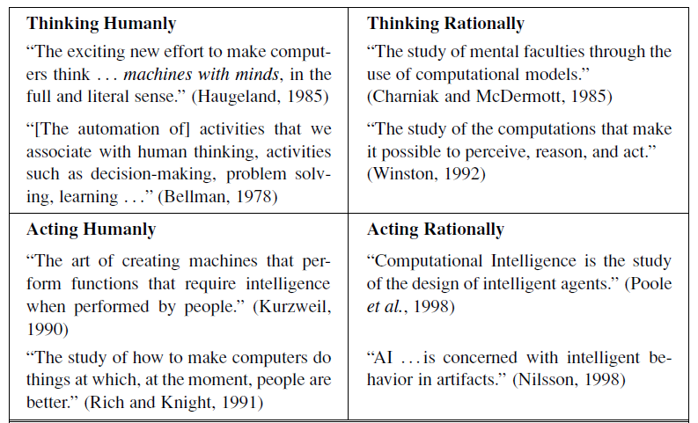
WHAT IS ARTIFICIAL INTELIGENCE (AI)?
Data Squad | Intro to AI

Slide 4
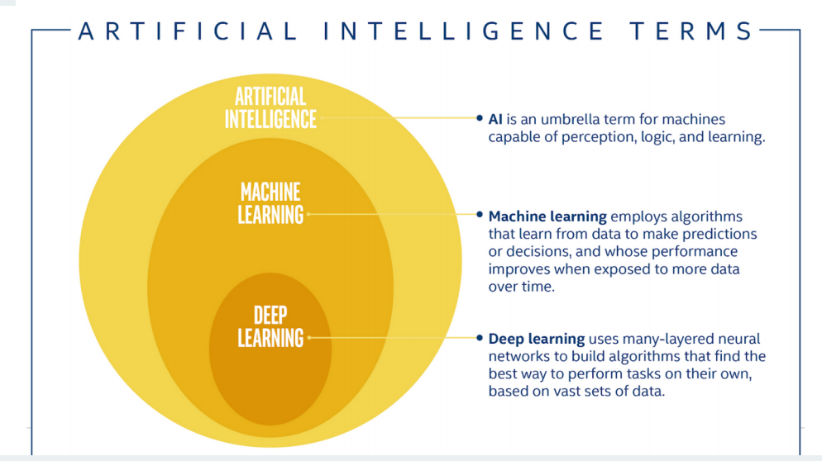
SOME DEFINITIONS
Data Squad | Intro to AI

Slide 5
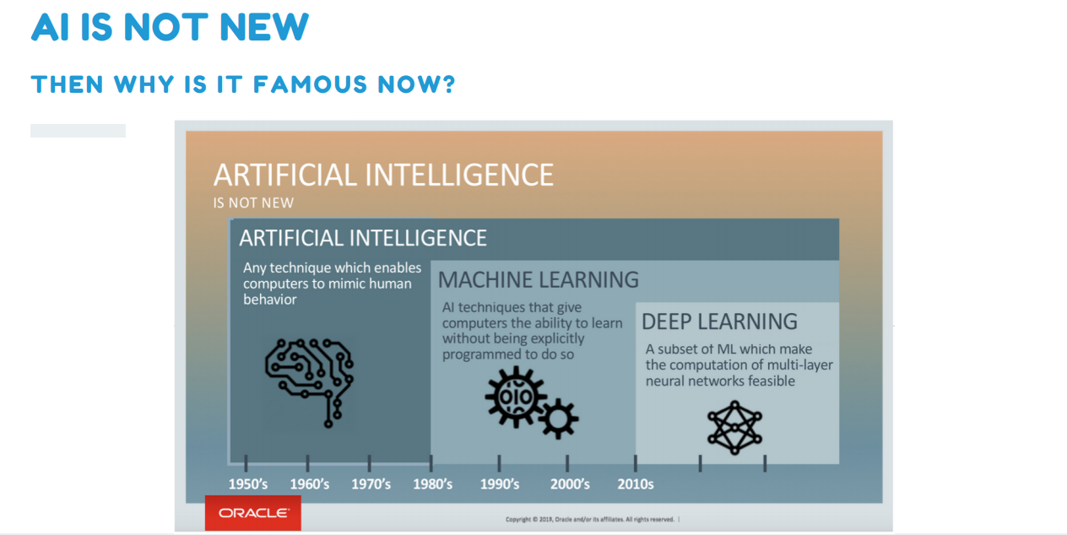
Data Squad | Intro to AI

Slide 6
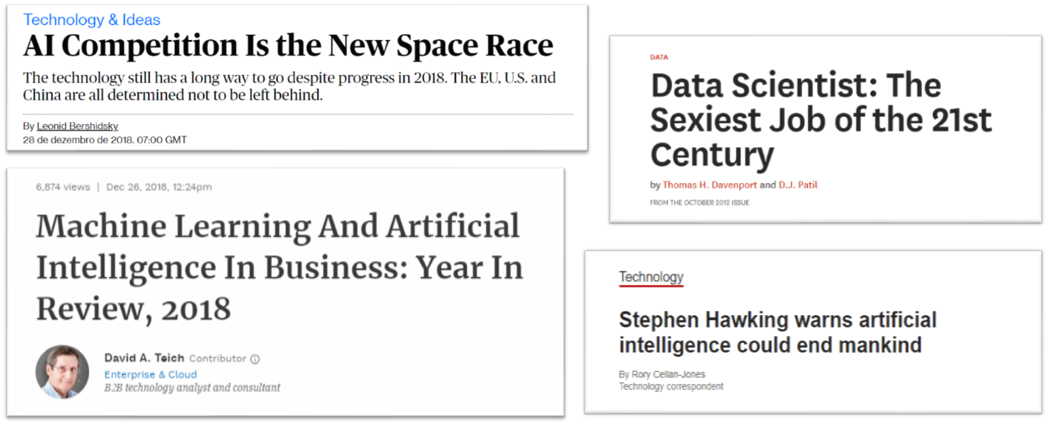
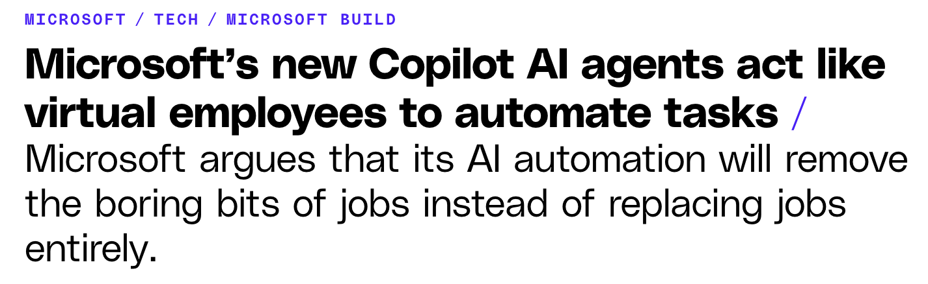
HOT TOPIC IN OUR SOCIETY
Data Squad | Intro to AI

Slide 7
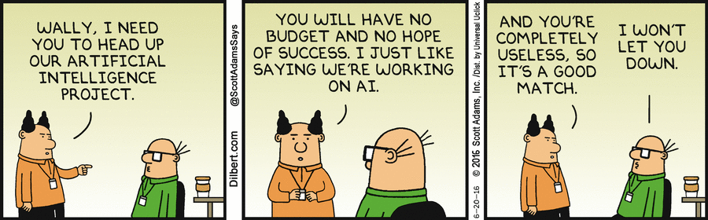
HOT TOPIC IN OUR SOCIETY
Data Squad | Intro to AI

Slide 8
Above everything... computational power
"Finally" we are able to properly do AI
Data Squad | Intro to AI

Slide 9
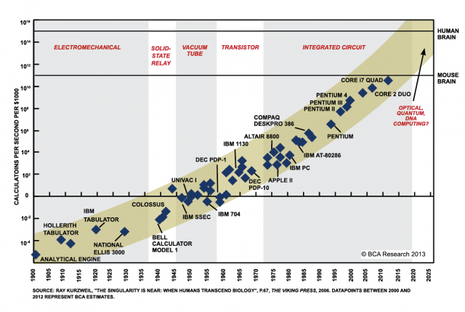
Data Squad | Intro to AI

Slide 10
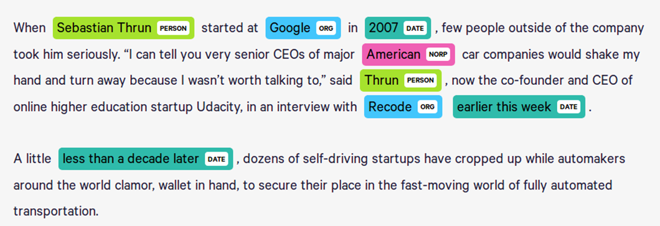
WHAT TYPE OF APPLICATIONS CAN BE SOLVED WITH AI?
Named Entity Recognition
Use Case: Know-Your-Client Teams / Reading Contracts
Whenever there is a new client/contract, thousands of pages
must be read and validated for compliance purposes,
usually only to identify potential issues/threaths
Data Squad | Intro to AI

Slide 11
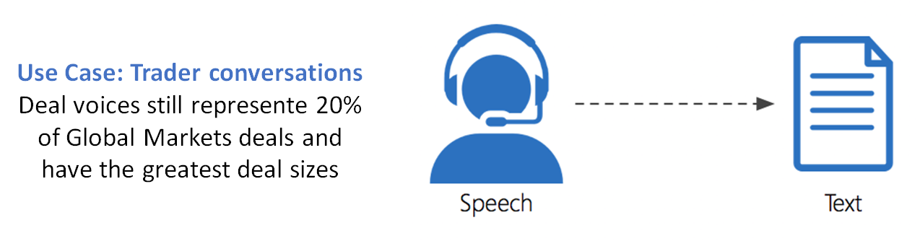
WHAT TYPE OF APPLICATIONS CAN BE SOLVED WITH AI?
Speech To Text
+ use cases: You can imagine others...
Data Squad | Intro to AI

Slide 12
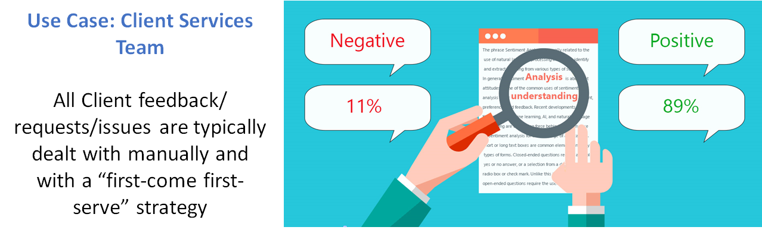
WHAT TYPE OF APPLICATIONS CAN BE SOLVED WITH AI?
Sentiment Analysis
Data Squad | Intro to AI

Slide 13
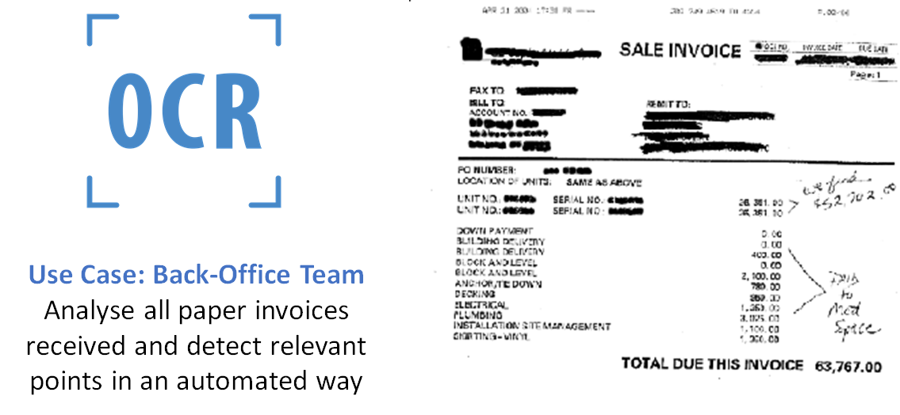
WHAT TYPE OF APPLICATIONS CAN BE SOLVED WITH AI?
(OCR ) Optical Character Recognition
Data Squad | Intro to AI

Slide 14
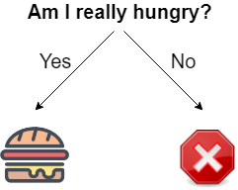
WHAT IS A DECISION?
Data Squad | Intro to AI

Slide 15
HARD CODED RULES
If Else Statements to perform decisions based on conditions defined by our understanding of the problem
DISADVANTAGES:
Has the disadvantage that clearly we cannot code all possible cases
We might be choosing the wrong rules
Example: Hardcoding words to build a Spam Email Filter
Data Squad | Intro to AI

Slide 16
MACHINE LEARNING: WHAT IS IT?
In Machine Learning the objective is to make a prediction
Based on information, like in the previous example
BUT
The tree presented before is created in a learning process based on all the information available and on historical data points
Data Squad | Intro to AI

Slide 17
MAKING DECISIONS IN MACHINE LEARNING
There has to be a set of options available - big handycap from the machines
There is usually some uncertainty associated with the decision made
One decision can then affect the subsequent decisions you take
Data Squad | Intro to AI

Slide 18
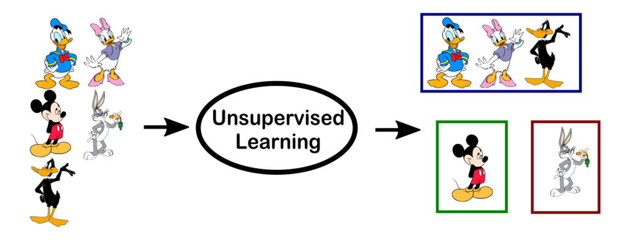



MACHINE LEARNING EXAMPLE: DISNEY VS WB
Disney or WB?
Data Squad | Intro to AI

Slide 19
MACHINE LEARNING EXAMPLE: DISNEY VS WB
Disney or WB?
Data Squad | Intro to AI

Slide 20
MACHINE LEARNING: SUPERVISED VS UNSUPERVISED
Supervised ML problem:
[...] Machine Learning task of learning a function that maps an input to an output based on example input-output pairs.[1]
Unsupervised learning problem:
[...] a type of algorithm that learns patterns from untagged data.
[1] Stuart J. Russell, Peter Norvig (2010) Artificial Intelligence: A Modern Approach, Third Edition, Prentice Hall ISBN 9780136042594.
Data Squad | Intro to AI

Slide 21
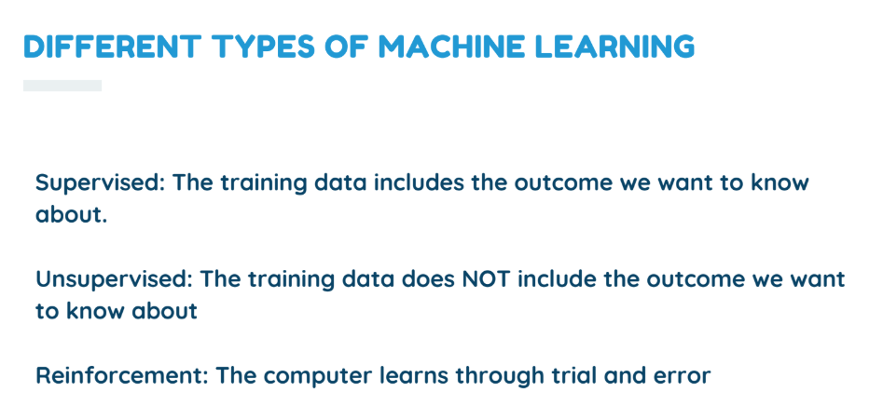
Data Squad | Intro to AI

Slide 22
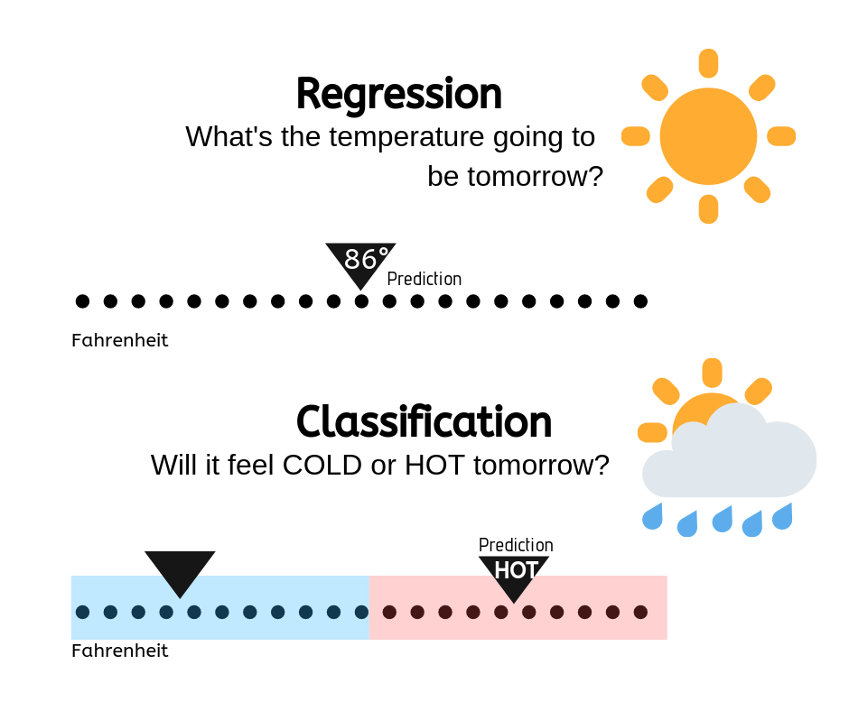
MACHINE LEARNING: TYPES OF SUPERVISED PROBLEMS
In Machine Learning a particular problem can either be a Classification or Regression problem.
The difference is in the type of variable we are trying to predict
Continuous/Numerical : Regression Problem
Categorical: Classification Problem
Data Squad | Intro to AI

Slide 23
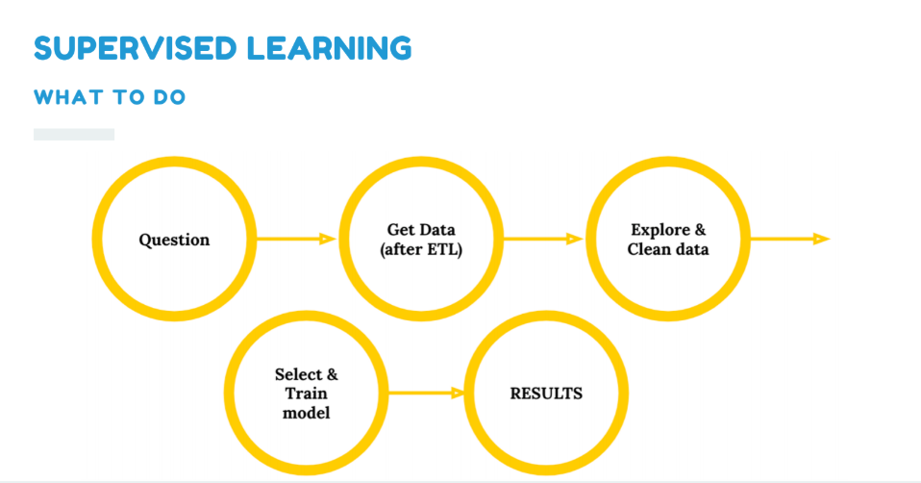
Data Squad | Intro to AI

Slide 24
MACHINE LEARNING EXAMPLE: DISNEY VS WB
Disney or WB?
Data Squad | Intro to AI

Slide 25
MACHINE LEARNING EXAMPLE: DISNEY VS WB
Disney or WB?
Data Squad | Intro to AI

Slide 26
MACHINE LEARNING: UNSUPERVISED
Data Squad | Intro to AI

Slide 27
MACHINE LEARNING: UNSUPERVISED
Data Squad | Intro to AI

Slide 28
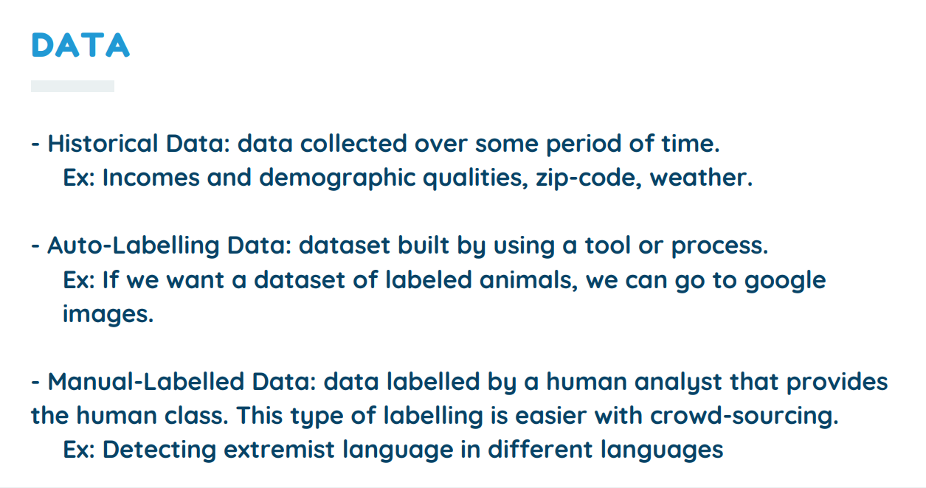
Data Squad | Intro to AI

Slide 29

WHY PYTHON?
Scikit Learn
https://scikit-learn.org/stable/
Data Squad | Intro to AI

Slide 30
WHY PYTHON?
Scikit Learn
TensorFlow
Data Squad | Intro to AI

Slide 31
WHY PYTHON?
Scikit Learn
TensorFlow
PyTorch
Data Squad | Intro to AI

Slide 32
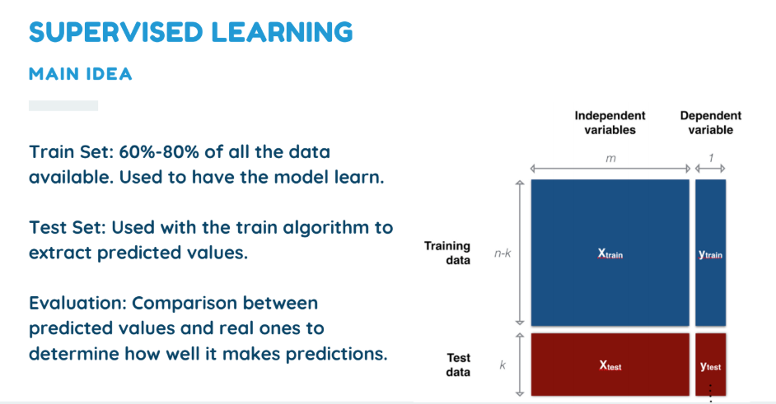
Data Squad | Intro to AI

Slide 33
ANY QUESTIONS ?

Slide 34
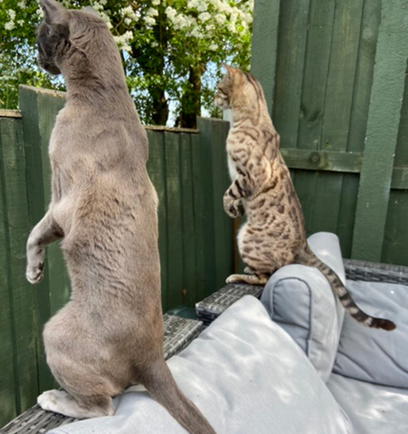
TODAY: WE WILL LEARN ABOUT OUR FIRST ALGORITHM
K- Nearest Neighbours (KNN)
Can be used for both classification or regression
Supervised ML Algorithm
Assumes that similar things are "closer* together"
*Question for next classes: what does closer mean?
Data Squad | Intro to AI

Slide 35
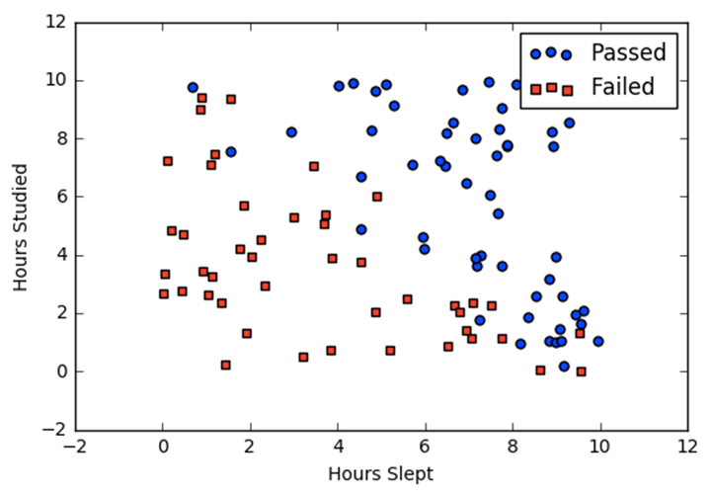
KNN: THE ALGORITHM
Imagine you have two independent variables: Hours Slept and Hours studied
These are known as our features
or inputs.
We are trying to predict if a person with certain hours studied and hours slept before a test will pass or fail.
The category pass or fail is an example of the target variable we are trying to predict in supervised ML
Data Squad | Intro to AI

Slide 36
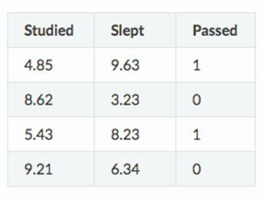

KNN: THE ALGORITHM
The process involved mapping the points available to the feature space
Very Simple Training Process -> there are no model parameters to optimise only
hyperparameter K (number of neighbours)
Data Squad | Intro to AI

Slide 37
KNN: THE ALGORITHM
The process involved mapping the points available to the feature space
K = 3
Insert a new point from the test data set
Evaluate the 3 closest neighbours
Data Squad | Intro to AI

Slide 38
KNN: THE ALGORITHM
The process involved mapping the points available to the feature space
K = 3
Insert a new point from the test data set
Evaluate the 3 closest neighbours
Data Squad | Intro to AI

Slide 39
KNN: THE ALGORITHM
The process involved mapping the points available to the feature space
Apply a majority vote system
And assign the class of the winner.
Data Squad | Intro to AI

Slide 40
KNN: THE ALGORITHM
What if it were regression?
Evaluate the neighbours and perform an anverage of the target variable's results
Data Squad | Intro to AI

Slide 41
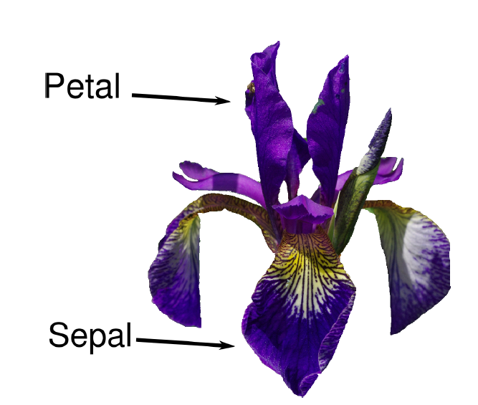
PYTHON CODE TIME
Iris Dataset
Data Squad | Intro to AI

Slide 42
EXAMPLES
(Lets see it in Python)
Data Squad | Intro to AI

Slide 43
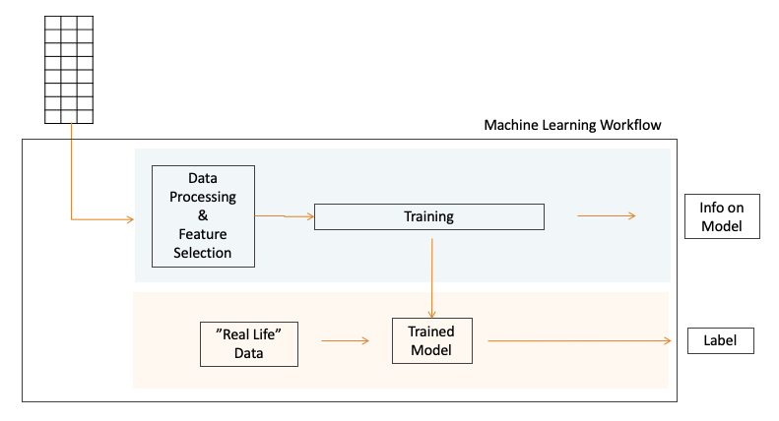
PYTHON CODE TIME
Data Squad | Intro to AI

Slide 44
ANY QUESTIONS ?

Slide 45
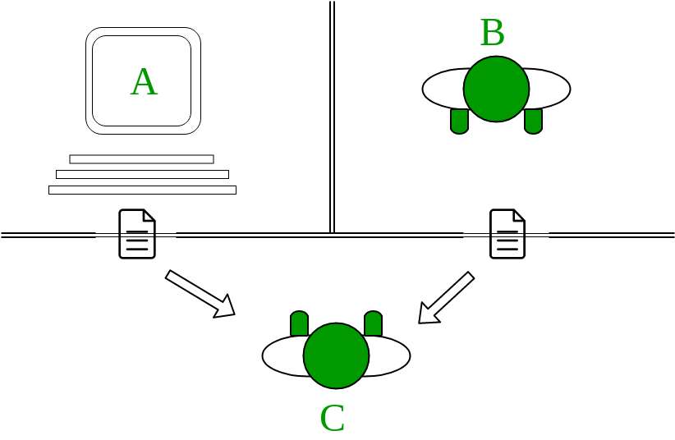
TURING TEST
Data Squad | Intro to AI

Slide 46
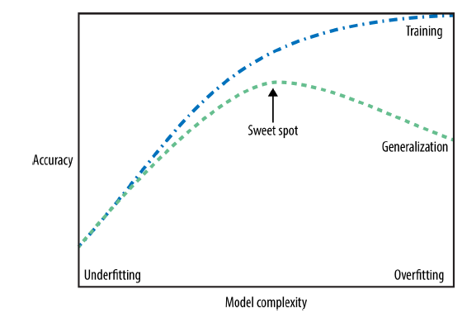
GENERALIZATION, UNDERFITTING & OVERFITTING
Data Squad | Intro to AI

